Slide 1
Traveling Salesman Problem
Il-Chul Moon
Department of Industrial and Systems Engineering
KAIST

Slide 2
Homework Objectives
Implement a genetic algorithm to solve a traveling salesman problem
Initial implementation will be provided, what you need to do is enhancing it.
The list of cities and their locations will be provided
No restrictions in the strategies of
Encoding
Selection
Crossover
Mutation
Substitution
No restrictions in the parameter choices
Size of population
Size of offspring
Number of mutated genes
Etc….
Restrictions will be imposed only on
The dataset, or the cities and their locations
The running time
The execution structure
The output structure

Slide 3
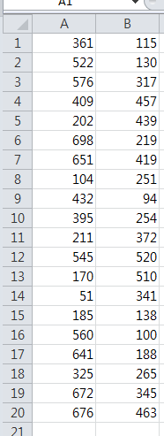
Dataset
Structure of the dataset
In the given implementation, the cities are randomly created.
Change this to read from a csv file format
You can open it with MS Excel
You can open it with a notepad
Each cell is separated by the comma and the row
How to read the dataset
xlsread
Your friend in Week 1 and Week 2 of offline sessions
Try a sample
TSP1.csv
X and Y coordinates of 20 cities

Slide 4
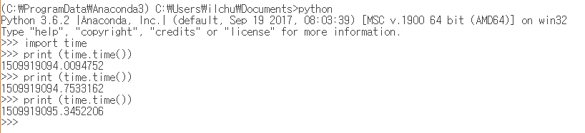
Running time
Search Python’s time.time() function
Your code should terminate in the given time constraint
With an acceptable time window of 2 secs
So, if the program should terminate in 180 secs,
178~182 secs are fine

Slide 5
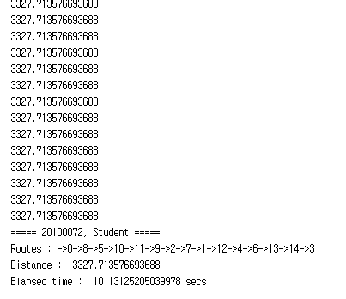
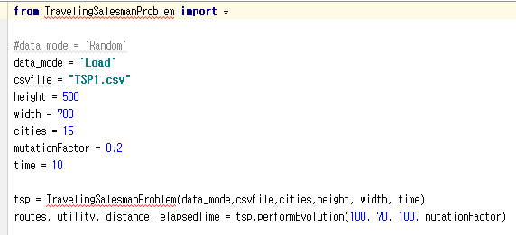
Execution and output structures
Expected Output
TA will execute “TSPExecution.py”
He will touch nothing but the play button.
Do set your program to terminate in 180 secs.
Make sure that your program
TSPExecution.m should read in “TSP1.csv”
The file will not same to the distributed version
City locations will be changed
The file that you read will have the same name

Slide 6
Grading criteria
Criteria for scores
Mechanical points (30 pts)
Following the specification
Time constraints
Execution, output specifications
Strategy points (40 pts)
Your implementation of GA encoding, selection, crossover, mutation, substitution strategies
OR, an idea from a research paper or a textbook
This case do identify your source.
Remember the syllabus for the case of plagiarism
Judged in terms of its soundness and novelty by the professor
Competition points (20 pts)
Based upon the dataset score
The evaluation dataset will be in the same format
But in the different values
Software structure points (10 pts)
The goodness of the structure of your implementation

Slide 7
Homework Deliverables
By 11:59pm, May. 14
You will submit a zip file of
Python files
Your implementations
You are free to make additional modules, files, classes, functions to solve the problem
Reports
N pages of
Your strategies on the GA steps
Your parameter choice experiment results
Citations upon referenced materials
These are based upon your implementations!
Via KLMS

